Slide 1
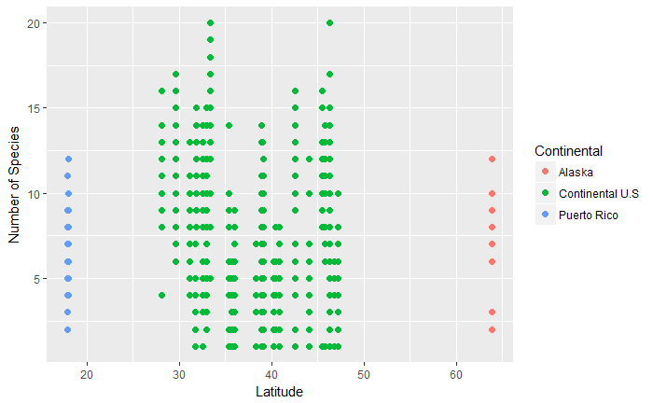
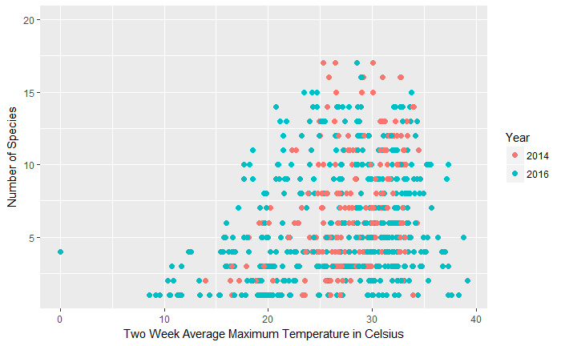
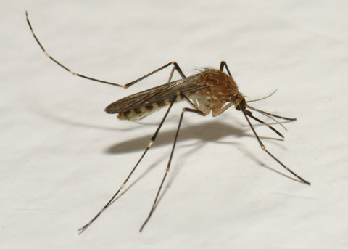
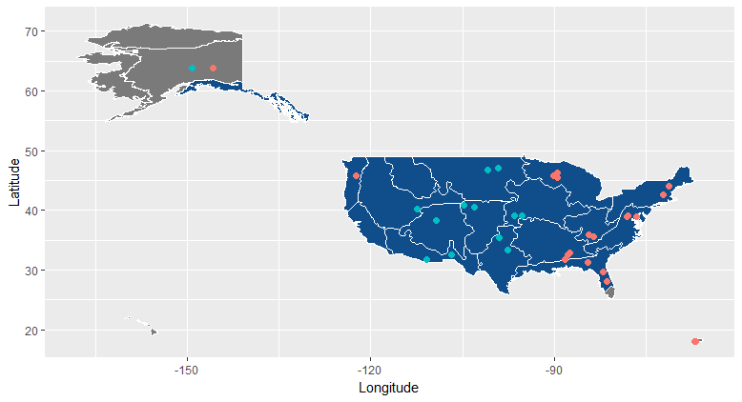
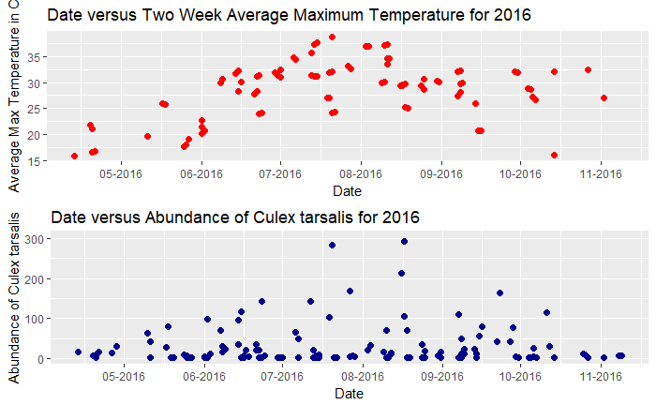
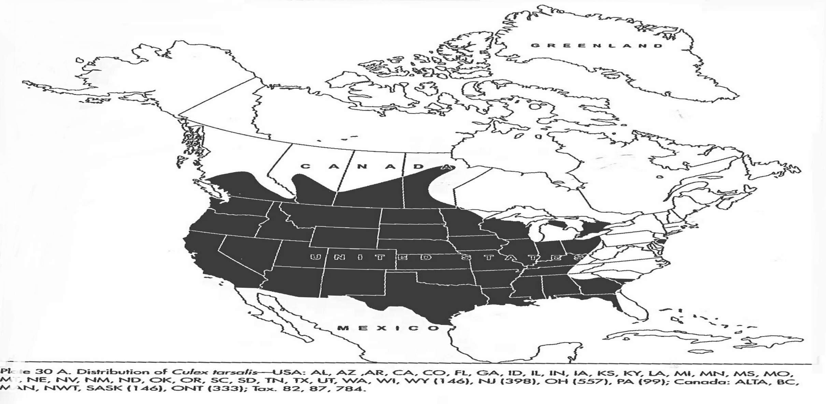

Methods of Exploring Spatial Patterns and Mapping NEON Mosquito Data in R
Charlotte Roiger
Introduction
Vignette One: Species Richness
Vignette One: Species Richness
Vignette Two: Abundance and Range of Culex tarsalis
Background: The study of mosquitoes is important because of their roles as members of food chains, carriers for human diseases, and as a sentinel taxon for climate change¹. The National Ecological Observatory Network (NEON) will be collecting mosquito occurrence, identification, and pathogen data at 47 terrestrial sites over the next 30 years.
Project Goals: The aim of this research project is to develop and provide future data users with methods and examples of working with NEON mosquito data to facilitate data analysis and visualization using the R programming language. We present a general workflow for downloading, merging, and processing data from NEON’s mosquito data product to explore and visualize species richness across all NEON sites. The tutorial includes examples of how to combine field observations with meteorological data to explore the relationship between mosquito species richness and temperature thresholds. The broad spatial distribution of NEON sites may enable early detection of mosquito species range expansion. We show how these data can be used to analyze the presence or absence of a single species, Culex tarsalis, across NEON sites.
Figure 1. Scatterplot of Species Richness by Latitude
Figure 2. Scatterplot of Species Richness by two week average maximum temperature in degrees Celsius
Figure 3. Picture of a female Culex tarsalis³
Vignette Two: Abundance and Range of Culex tarsalis
Vignette Two: Abundance and Range of Culex tarsalis
Native Status
Methods
Native
Absent
Data Organization and Set Up
Retrieve NEON Location Information
Used a function that called NEON Application Program Interfaces to obtain location data
Merge trapping, identification, and sorting data frames
Vignette One: Mosquito Species Richness
Calculate Species Richness
Counted the unique number of scientific names at each sampling site by using the ‘ddply’ function
Create Temperature and Degree Day Variables
Created a temperature lag function that calculated the average maximum temperature and number of days above 16º Celsius two weeks prior to sampling²
Applied the temperature lag function to a species richness data frame using the ‘mapply’ command
Vignette Two: Abundance and Range of Culex tarsalis
Calculate Abundance
Create a subsample multiplier to estimate the number of individuals in each sample
Sum individual count from samples by site identification and date
Visualize Culex tarsalis Range
Download NEON domain shapefiles
Create indicator variable of Culex tarsalis native status and sampling presence
Use the ‘ggplot2’ package to visualize NEON domain map
Culex tarsalis Present in Samples
Present
Not Present
Figure 5. Map of the range of Culex tarsalis. White lines indicate NEON domain boundaries and dots are NEON sampling sites. Data used to generate this map was collected from the years 2014 and 2016.
Figure 4. Scatter plot of two week average maximum temperature by date for 2016(top). Scatter plot of Culex tarsalis abundance by date for 2016 (bottom).
Native Status
Acknowledgments
Native
Special thanks to Cody Flagg, Megan Jones, and Katie LeVan for providing mentorship, coding expertise, and support throughout the creation of this data tutorial.
Absent
Figure 6. Map of the range of Culex tarsalis from “Identification and Geographical Distribution of the Mosquitoes of North America, North of Mexico” published in 2005⁴.
References
Hoekman, D., Y. P. Springer, C. M. Barker, R. Barrera, M. S. Blackmore, W. E. Bradshaw, D. H. Foley, H. S. Ginsberg, M. H. Hayden, C. M. Holzapfel, S. A. Juliano, L. D. Kramer, S. L. LaDeau, T. P. Livdahl, C. G. Moore, R. S. Nasci, W. K. Reisen, and H. M. Savage. 2016. Design for mosquito abundance, diversity, and phenology sampling within the National Ecological Observatory Network. Ecosphere 7:1–13.
Ciota, A., M. A., K. A., K. L. 2014. The Effects of Temperature on Life History Traits of Culex Mosquitoes.
Bryant, P. J. 2007. Western Encephalitis Mosquito. Natural History of Orange County, California and Nearby Places. University of California, Irvine.
Darsie, R. F., R. A. Ward, C. C. Chang, and T. Litwak. 2005. Identification and geographical distribution of the mosquitoes of North America, north of Mexico. University Press of FloridaGainsville, FL.
For more information on project methods, access to code, and NEON mosquito data, please scan this QR code.

